Slide 1
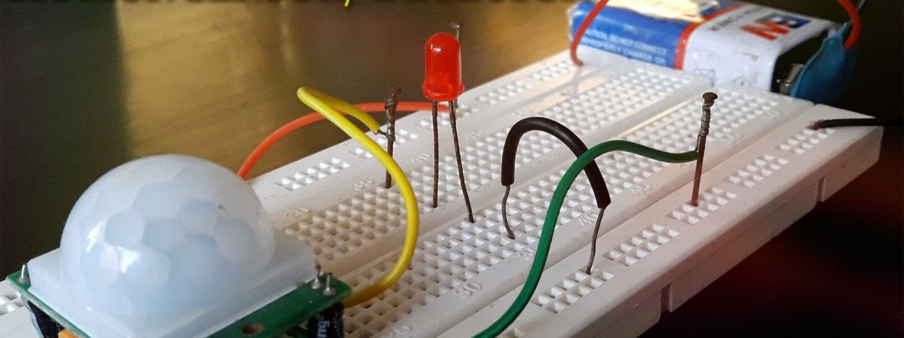
Semester project 2390l :Motion sensor activated motor
By Jordan Pierre and Jackandie Joanis

Slide 2
DOCUMENTATION

Slide 3
Components Needed:
Raspberry pi x1
Breadboard x1
PIR Motion Sensor x2
Micro Servo x1
LED’s x2
Rainbow Jumper Wires

Slide 4
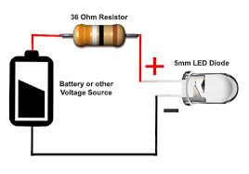
Step One: The Led(S)

Slide 5
Step One (Continued)

Slide 6
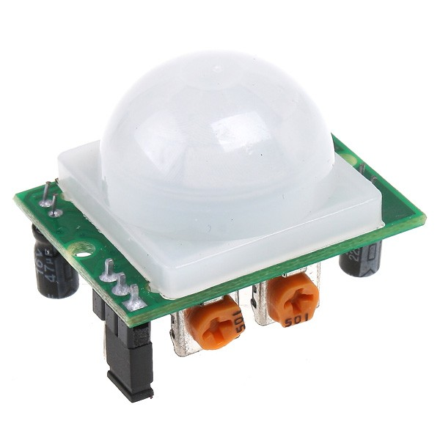
STEP TWO: The Motion Sensor

Slide 7
STEP TWO (Continued)

Slide 8
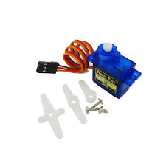
STEP FOUR: THE MOTOR

Slide 9
STEP FIVE : The culmination

Slide 10
Challenges

Slide 11
CONCLUSION

